Slide 1
Open Domain Question Answering
Kangqi Luo
2014-04-16

Slide 2
Agenda
Overview
Approaches
Semantic Parsing
Shallow Parsing
Conclusion
Notes:
Shallow Parsing: yes, the question is still need to be parsed, but not so deep as CCG/DCS

Slide 3
Overview
Notes:
幻灯片过渡，可以选择屏幕先暗下来，再慢慢变亮，显示这个页面
修改字体，以及下面加一条灰色（从左到右颜色深浅变化）的分割线，下面再加一个象征性的图

Slide 4
Overview
What is Question Answering (QA)
Input: Natural language question provided by human.
Output: The correct answer of the question.
What kind of question?
Open domain question
Factoid question
Q: “Who is the director of Avatar?”
Q: “What are the most largest 10 states in America?”
Q: “How to make a chest in Minecraft?”
Q: “Why is Shanghai rainy in April?”
Notes:
Open domain: the question can be asked in any field.
Factoid: the question associated with a fact. (maybe related to one or more entities, but the answer is a fact)
Factoid: the answer is a real fact associated with at least one entity. Often the answer is entity or value.

Slide 5
Overview
Why QA Task Important
Let the computer understand what a question means
Automatically extract the answer
Search from relevant documents
Look up structured knowledge bases
Notes:
QA is an important task in natural language processing
How to look up? Need a structured query to make computer understand. (That’s the result of step 1.)

Slide 6



Overview
A typical data flow of ODQA
“What inspired Mark Twain to write novel?”
Parsing Step
natural language question
User
influenced_by(mark_twain, ?)
structured query
answer
Executing Step
“Charles Dickens”, “William Dean Howells”, …

Slide 7
Approaches
Semantic Parsing
Combinatory Categorial Grammar
Shallow Parsing
Template-Based Model
Notes:
Differ from how the question is understood. Coarse grained / Fine grained

Slide 8
Semantic Parsing
Question → Structured Semantic Parsing Tree
Find the semantic meaning for almost every word / phrase.
Use hierarchical structure to combine meanings.
Root: final semantic expression of the question.
Easily convert to structure queries.
SPARQL
Notes:
(Deeply understand what the question means.)
Different definitions may get different methods
Semantic parsing can do many things, not only for QA

Slide 9
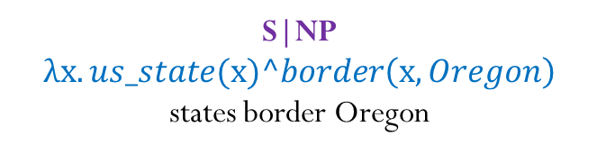

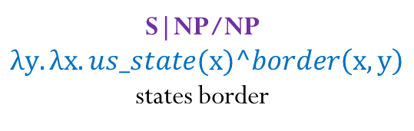
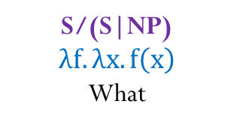
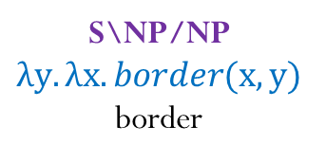
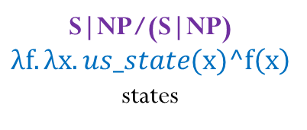
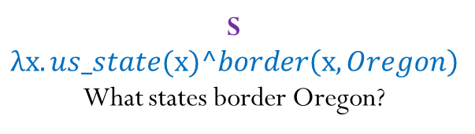
Semantic Parsing
At a First Glance
“What states border Oregon?”
$λx.us_state(x)^border\left(x,Oregon\right)$
PREFIX rdf:<http://rdf.freebase.com/ns/> SELECT ?answer FROM <http://freebase.com> WHERE { ?answer rdf:type.object.type rdf:location.us_state . ?answer rdf:location.location.border rdf:m.05kj_ .}
S
$$λx.us_state(x)^border\left(x,Oregon\right)$$
What states border Oregon?
S|NP
$$λx.us_state(x)^border\left(x,Oregon\right)$$
states border Oregon
S|NP/NP
$$λy.λx.us_state(x)^border\left(x,y\right)$$
states border
S/(S|NP)
$$λf.λx.f\left(x\right)$$
What
S|NP/(S|NP)
$$λf.λx.us_state(x)^f\left(x\right)$$
states
S\NP/NP
$$λy.λx.border(x,y)$$
border
NP
Oregon
Oregon
Notes:
Rep. on FB (Specific KB)

Slide 10
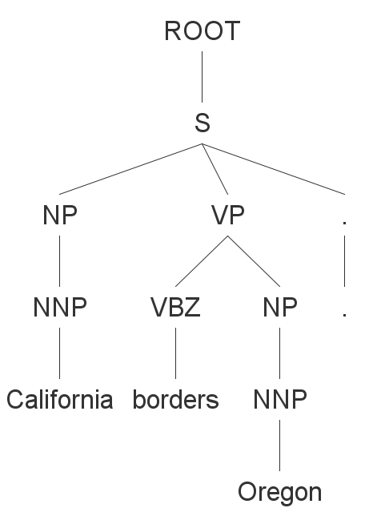
Combinatory Categorial Grammar
Do you remember Context Free Grammar (CFG) ?
S :- NP VP .
NP :- NNP
VP :- VBZ NP
NNP :- California
VBZ :- borders
……
“California borders Oregon.”
Notes:
CCG和CFG是可以类比的。都是涉及到rule，然后合并。最好能够动态展示CCG的过程。讲清楚CCG和CFG的类比。
What is a grammar? A grammar is a set of rules that guides you to build a tree that makes sense.

Slide 11
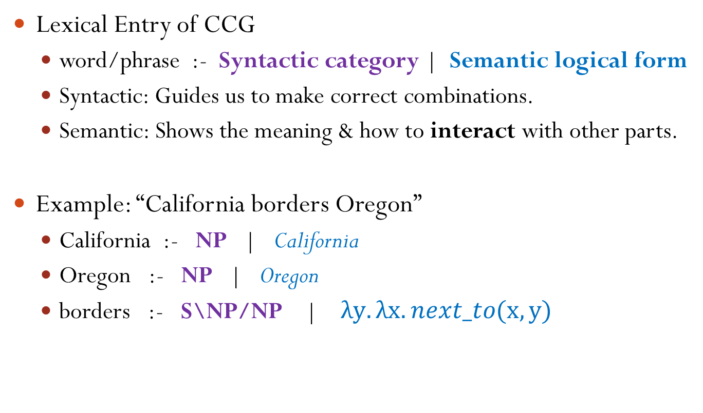
Combinatory Categorial Grammar
Lexical Entry of CCG
word/phrase :- Syntactic category | Semantic logical form
Syntactic: Guides us to make correct combinations.
Semantic: Shows the meaning & how to interact with other parts.
Example: “California borders Oregon”
California :- NP | California
Oregon :- NP | Oregon
borders :- S\NP/NP | $λy.λx.next_to(x,y)$
Notes:
S，NP，N之类的意义，至少要给个解释（为什么没有V） One word/phrase can have more than one lexical entry, since it may have several meanings.

Slide 12
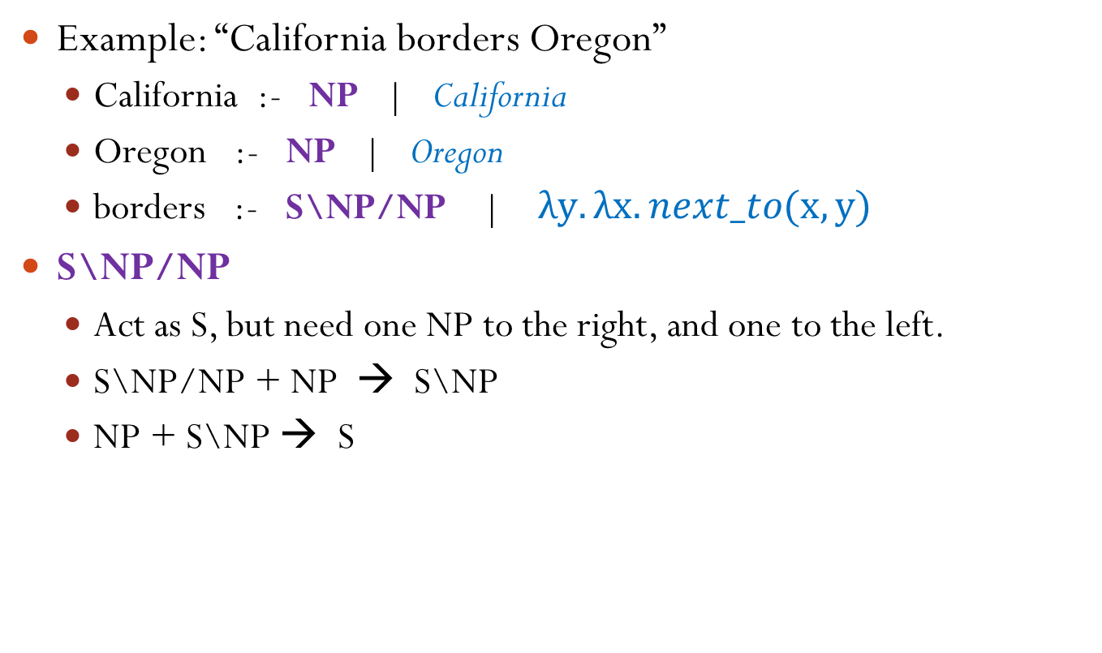
Combinatory Categorial Grammar
Example: “California borders Oregon”
California :- NP | California
Oregon :- NP | Oregon
borders :- S\NP/NP | $λy.λx.next_to(x,y)$
S\NP/NP
Act as S, but need one NP to the right, and one to the left.
S\NP/NP + NP → S\NP
NP + S\NP → S
Notes:
Once combined with others, they’ll assigned.

Slide 13
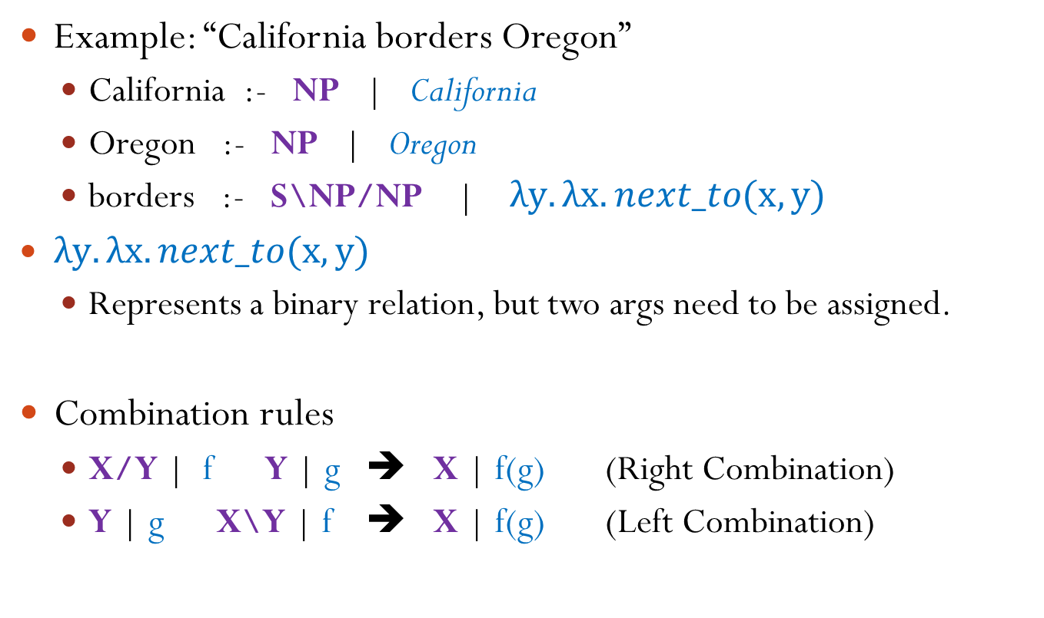
Combinatory Categorial Grammar
Example: “California borders Oregon”
California :- NP | California
Oregon :- NP | Oregon
borders :- S\NP/NP | $λy.λx.next_to(x,y)$
$λy.λx.next_to(x,y)$
Represents a binary relation, but two args need to be assigned.
Combination rules
X/Y | f Y | g ➔ X | f(g) (Right Combination)
Y | g X\Y | f ➔ X | f(g) (Left Combination)
Notes:
Once combined with others, they’ll assigned.
X/Y : f Y/Z : g ⇒ X/Z : λx.f (g(x))

Slide 14
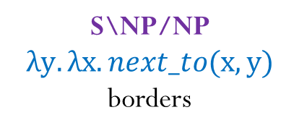
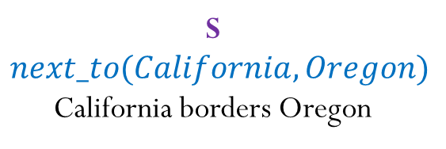
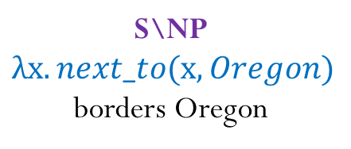
Combinatory Categorial Grammar
Example: “California borders Oregon”
X/Y | f Y | g ➔ X | f(g) (Right Combination)
Y | g X\Y | f ➔ X | f(g) (Left Combination)
S
$$next_to(California, Oregon)$$
California borders Oregon
S\NP
$$λx.next_to(x, Oregon)$$
borders Oregon
NP
California
California
S\NP/NP
$$λy.λx.next_to(x,y)$$
borders
NP
Oregon
Oregon
Notes:
Not going to talk about all rules, if you are interested, please look at the original sample.

Slide 15
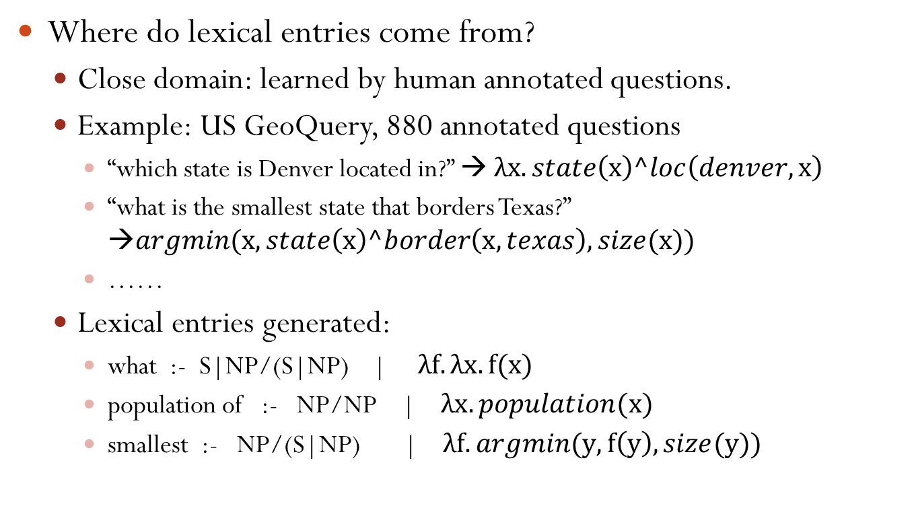
Combinatory Categorial Grammar
Where do lexical entries come from?
Close domain: learned by human annotated questions.
Example: US GeoQuery, 880 annotated questions
“which state is Denver located in?” → $λx.state\left(x\right)^loc\left(denver,x\right)$
“what is the smallest state that borders Texas?” →$argmin(x, state\left(x\right)^border\left(x,texas\right),size(x))$
……
Lexical entries generated:
what :- S|NP/(S|NP) | $λf.λx.f(x)$
population of :- NP/NP | $λx.population(x)$
smallest :- NP/(S|NP) | $λf.argmin(y, f\left(y\right), size(y))$

Slide 16
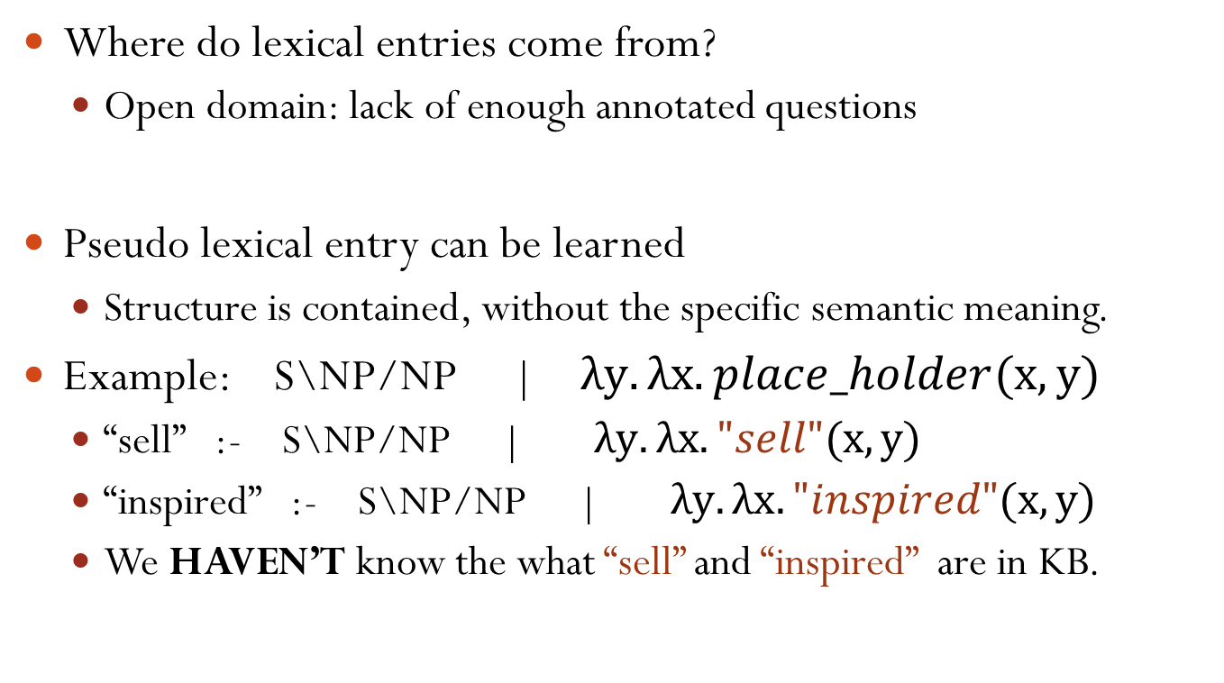
Combinatory Categorial Grammar
Where do lexical entries come from?
Open domain: lack of enough annotated questions
Pseudo lexical entry can be learned
Structure is contained, without the specific semantic meaning.
Example: S\NP/NP | $λy.λx.place_holder(x, y)$
“sell” :- S\NP/NP | $λy.λx."sell"(x, y)$
“inspired” :- S\NP/NP | $λy.λx."inspired"(x, y)$
We HAVEN’T know the what “sell” and “inspired” are in KB.
Notes:
The template is rich enough to construct the semantic parsing tree.

Slide 17
CCG In ODQA
Three Steps for Answering a Question:
S1. Build the tree by pseudo lexical entries.
S2. Collapse / expand the expression, if necessary.
S3. Mapping placeholders into real meanings in Freebase.
Notes:
Build the tree, get the style of representation. (Although we don’t know the exact meaning)

Slide 18






CCG In ODQA – Running Example
“how many people visit the public library of new york annually”
S1. Build the tree by pseudo lexical entries.
→ $λx.eq(x, count(λy.People\left(y\right) \& ∃ev.$ $Visit\left(y, lz.Public\left(z\right) \& Library\left(z\right) \& Of\left(z,NewYork\right),ev\right)$ $\& Annually(ev)))$

Slide 19
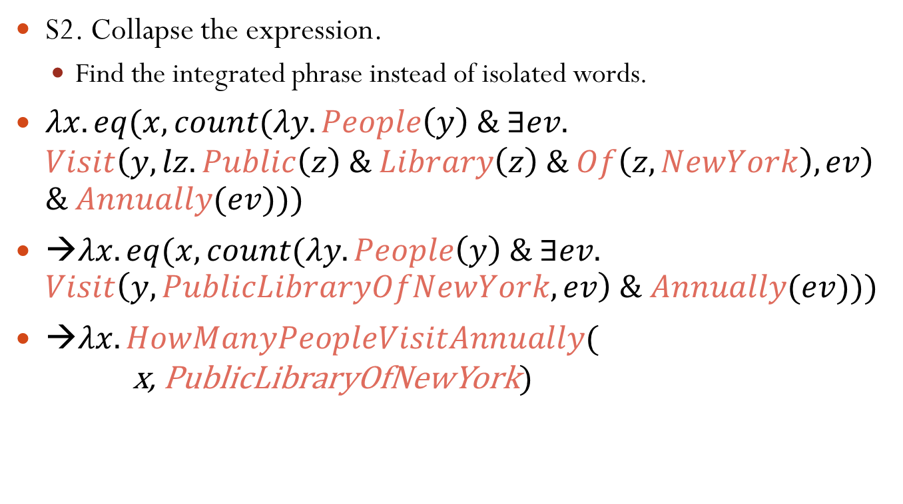
CCG In ODQA – Running Example
S2. Collapse the expression.
Find the integrated phrase instead of isolated words.
$λx.eq(x, count(λy.People\left(y\right) \& ∃ev.$ $Visit\left(y, lz.Public\left(z\right) \& Library\left(z\right) \& Of\left(z,NewYork\right),ev\right)$ $\& Annually(ev)))$
→$λx.eq(x, count(λy.People\left(y\right) \& ∃ev.$ $Visit\left(y,PublicLibraryOfNewYork,ev\right) \& Annually(ev)))$
→$λx.HowManyPeopleVisitAnnually($ x, PublicLibraryOfNewYork$)$

Slide 20
CCG In ODQA – Running Example
S3. Placeholders → Freebase object names
Guided by lexical & Wiktionary features
Shared words, Wiktionary synonyms
Overlap between definitions in Wiktionary
PublicLibraryOfNewYork → “New York Public Library”
http://www.freebase.com/m/01hyd9
HowManyPeopleVisitAnnually → “AnnualVisit” (FB Relation)
http://www.freebase.com/library/public_library_system/annual_visits

Slide 21
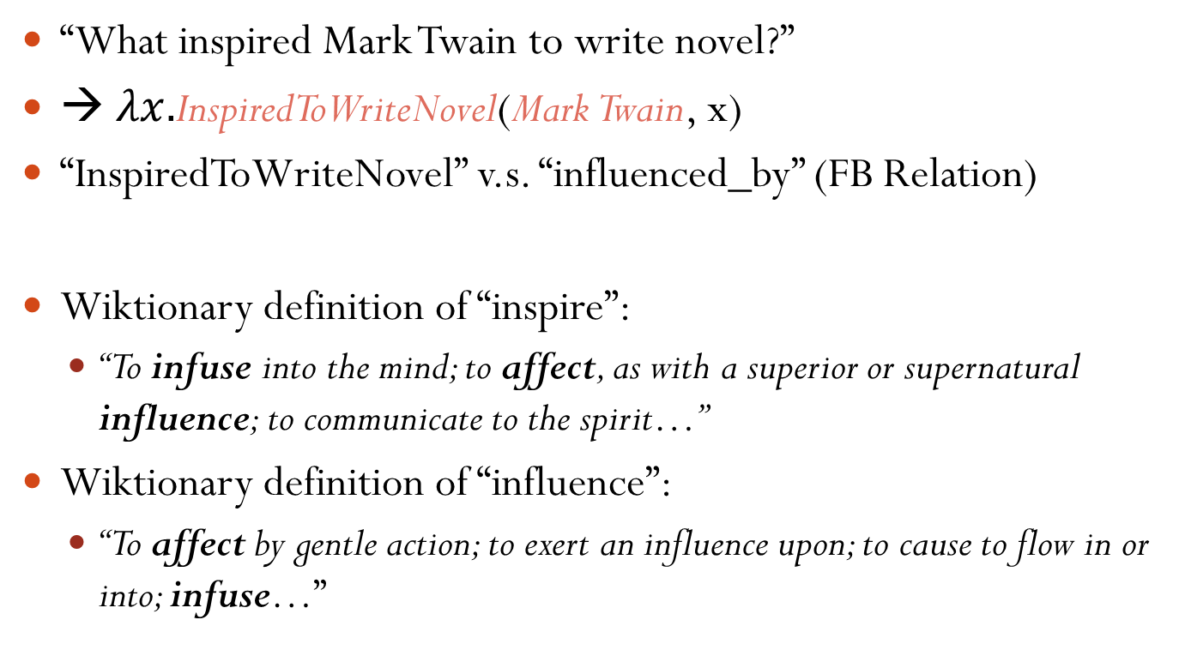
CCG In ODQA – Running Example
“What inspired Mark Twain to write novel?”
→ $λx.$InspiredToWriteNovel(Mark Twain, x)
“InspiredToWriteNovel” v.s. “influenced_by” (FB Relation)
Wiktionary definition of “inspire”:
“To infuse into the mind; to affect, as with a superior or supernatural influence; to communicate to the spirit…”
Wiktionary definition of “influence”:
“To affect by gentle action; to exert an influence upon; to cause to flow in or into; infuse…”

Slide 22
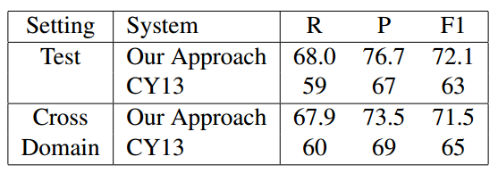
CCG Precision
Dataset: 917 open domain question annotate by Cai & Yates.

Slide 23
CCG Summary
Advantages
Rich information to represent a word / phrase.
Syntactic category helps easily construct a tree.
Able to handle factoid questions with complex syntactic structure.
Disadvantages
Multiple lexical entries for one word / phrase.
Expertise is needed to annotate questions.
Collapse/expand operation is rule based.
Notes:
Multiple expressions (due to different usage), EVEN the word itself is not ambiguous. Computational challenge.
Expertise, large human labor. (can’t AMT), hard to learn every usage from < 1000 examples (especially for words like “to” “for”…)
Rule-based expand/collapse, need improvement.

Slide 24
Shallow Parsing
Coarse-grained parsing strategy
Still need to convert a question into a formal representation.
Not combining each word’s semantic representation
Mainly focus on factoid question with simpler structure
“How many people are there in Honolulu?”
“Who is the wife of Barack Obama?”
……
Questions can be answered with single-relation queries.
Notes:
Since they don’t care how the words combine with each other, shallow parsing sometimes only deal with fq with simple structure.
Because we don’t care the structure of the question, it’s hard to get a final expression with a complex structure.

Slide 25
Template-Based Model
Different questions can ask for a same relation:
“Where was Barack Obama born?”
“Where was Yao Ming born?”
“Where was Shakespeare born?”
……
Generalize: “Where was $person born?”
That is a template.
Representing a set of questions with the same meaning.
Notes:
parsing是一种把问题用另一个形式去描述 (shallow parse)
That is a question template, or say, a general question, or say, representing a set of questions with the same meaning
“Once we know the predicate behind a template, we can easily answer a new question that satisfies this template.”

Slide 26
Template-Based Model
Need to do
A. Convert a question to a template.
B. Find the proper predicate behind each template.
Learned by existed QA pairs.
Training data: <Question, Answer> pairs from Yahoo! Answers
Q: “Where was Mark Twain born?”
A: “The novelist was born in Florida.”
Notes:
Actually, a learning process
here answer is a slightly different from what we said before. it’s a short text provided by users, containing the value of the question.
we ignore the process of answer extraction.

Slide 27
Template-Based Model
A. Convert a question to a template
Step 1. Entity Recognition
Distance between candidate entities and the answer in FB.
Q: “Where was Mark Twain born?” A: “Florida”
Best: Mark Twain (Novelist)
Candidate Entities | Shortest Path to Reach “Florida” in FB
Mark Twain (Novelist) | mark_twain → place_of_birth → florida
Mark Twain (Film) | mark_twain → director → ken_burns → nationality → united_states → contains → florida
Born (Comic book) | born → created_by → darick_robertson → nationality → united_states → contains → florida

Slide 28
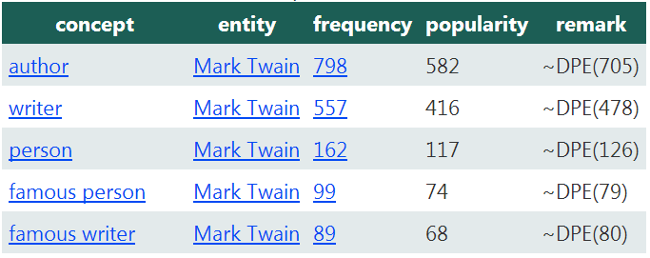
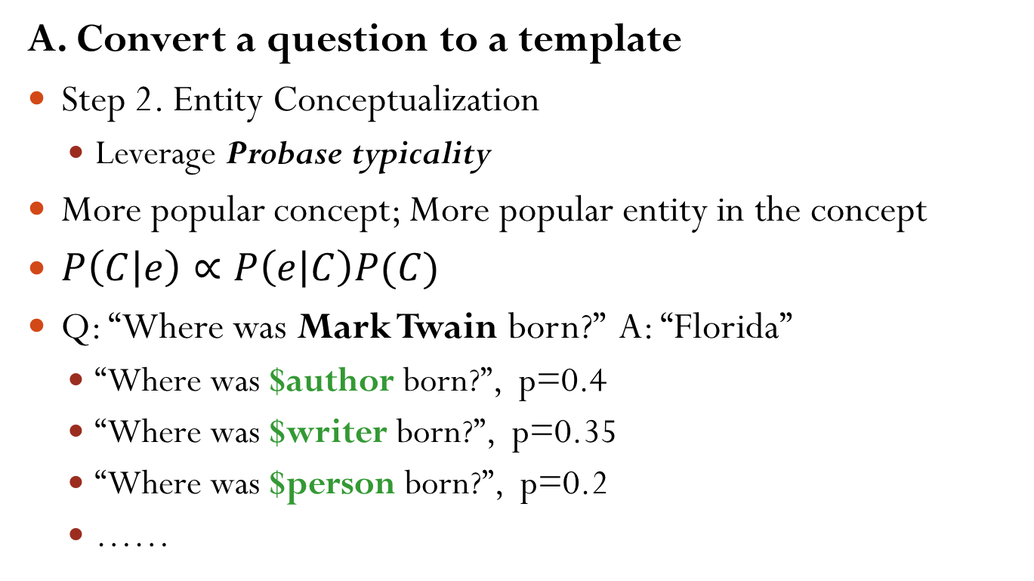
Template-Based Model
A. Convert a question to a template
Step 2. Entity Conceptualization
Leverage Probase typicality
More popular concept; More popular entity in the concept
$P\left(C | e\right)∝P\left(e | C\right)P(C)$
Q: “Where was Mark Twain born?” A: “Florida”
“Where was $author born?”, p=0.4
“Where was $writer born?”, p=0.35
“Where was $person born?”, p=0.2
……
Notes:
Entity Conceptualization: Get the entity’s concept distribution
Probase typicality: How typical the concept is, when the entity comes into your mind.
Actually the typicality score is a computational challenge, since it’s not so close to our human thought.
Challenge: Probase without disambiguation.
Here, p: weight of the question, given the template.

Slide 29

Template-Based Model
B. Predicate inference for each template
Through training QA pairs.
$P\left(P | T\right)∝P\left(P,T\right)=\sum_{q}{P\left(q\right)P\left(T | q\right)P\left(E,V | q\right)P(P|E,V)}$
Template → Questions → <Entity, Value> pairs → Predicate
E
Q
A
V
P
T
Notes:
What we have: A list of QA pairs.
Once T is given, it’ll guide the system to find related QA pairs. then based on these pairs, find the most suitable predicate

Slide 30
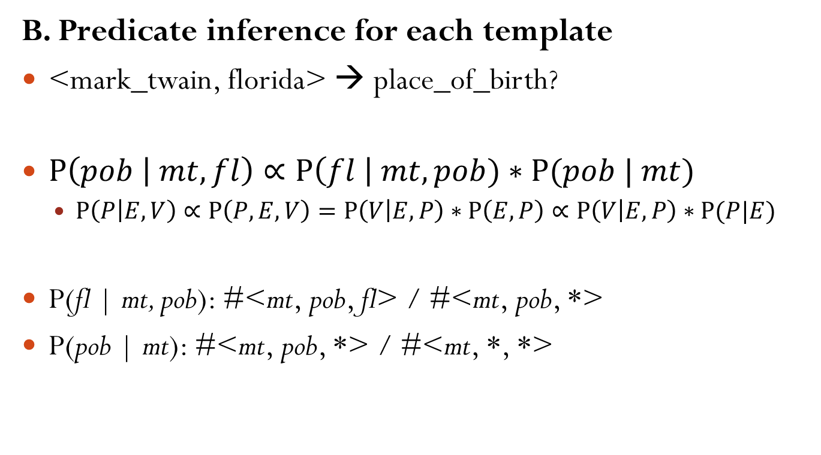
Template-Based Model
B. Predicate inference for each template
<mark_twain, florida> → place_of_birth?
$P\left(pob | mt, fl\right)∝P\left(fl \right| mt, pob)∗P(pob | mt)$
$P\left(P | E,V\right)∝P\left(P,E,V\right)=P\left(V | E,P\right)∗P\left(E,P\right)∝P\left(V | E,P\right)∗P(P|E)$
P(fl | mt, pob): #<mt, pob, fl> / #<mt, pob, *>
P(pob | mt): #<mt, pob, *> / #<mt, *, *>
Notes:
可以用白板笔在白板上推导，而不用写ppt
<S, P, O>: triple in Freebase.

Slide 31
Template-Based Model
Finally… A new question comes.
“What inspired Mark Twain to write novel?”
Template: “What inspired $author to write novel?”
Predicate: influenced_by(entity, value)
Final expression: influenced_by(mark_twain, ?)
Query & Answer: “Charles Dickens”, ……

Slide 32
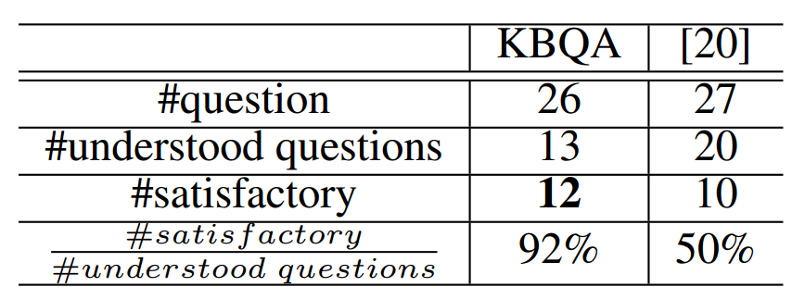
TBM Precision
Dataset: QALD (Question Answering on Linked Data)
26 single-relation questions from the dataset.

Slide 33
Conclusion
Key: convert a question to a structured representation in KB
Understood by computer
Room for Improvements
Incomplete CCG lexical entries
More accurate ways to perform relation mapping
Extract high quality factoid QA pairs
Fuzzy match technique in template-based model
(Semantic gap between them?)
Question paraphrase
Find nearest question in the semantic vector space
Notes:
917 sentences to learn CCG?
Yahoo answers not reliable?
Semantic Gap. between KB and question desc.

Slide 34
Reference
CCG
Scaling Semantic Parsers with On-the-fly Ontology Matching
Kwiatkowski et al., EMNLP 2013.
Lexical generalization in CCG grammar induction for semantic parsing
Kwiatkowski et al., EMNLP 2011.
Template-Based Model
KBQA: Question Answering over a Billion Scale Knowledge Base
Xiao et al., Draft for VLDB 2014.

Slide 35
Thanks For Listening!
Q & A

